Slide 1


Windows Server 2003:
Once a Cutting Edge OS; Now a Liability
Adam Bertram
adamtheautomator.com

Slide 2
Who Am I
Adam Bertram
17 Year IT Veteran
Microsoft MVP (Powershell)
Blogger: adamtheautomator.com
Technology Writer
Twitter: @adbertram

Slide 3
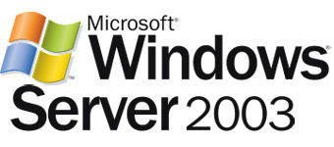
Why Are You Still on Server 2003?
But it still just works!
I've got other things to do
I just can't find the time
2
In just 2 months, Microsoft is officially "end of lifeing" Server 2003

Slide 4

July 14, 2015: The Day
July 14th, 2015
Microsoft officially proclaims Server 2003 as being dead.
No new security patches
No longer support the operating system
No support for applications such as Active Directory, SQL, Sharepoint, etc
Audit issues for regulations like HIPPA, HiTech, GLBA, PCI, etc
Limited support from other application vendors
Homeland security issued an alert on Server 2003 back in late 2014
https://www.us-cert.gov/ncas/alerts/TA14-310A

Slide 5
What about July 15th, 2015?
Can there be a security breach?
What if I get a call from the auditor?

Slide 6
Mitigating Vulnerabilities for Server 2003
Segment off old servers to quarantine them from the rest of the network
Apply host-based firewalls to old servers
Why go to all the headaches? Just do it already!

Slide 7
4 Phases For Migration
Inventory
Assessment
Migration
Decommissioning

Slide 8
Inventory
What do I have?
What does it do?

Slide 9
What Do I Have?
Software installed on the server
Hardware the OS is running on
Architecture (mostly x86), drive space, RAM, CPU etc.

Slide 10
Build a Checklist
Is it a domain controller?
Does it have SQL installed?
What version of SQL?
…..
Consider servers with multiple roles!

Slide 11
Line of Business Applications
Inventory vendors for LOB applications
Track down contact information for these vendors

Slide 12
Service Performance Considerations
Run performance metric reports on all your Server 2003 machines
Get a history of past performance
When testing, be cognisant of hardware differences

Slide 13

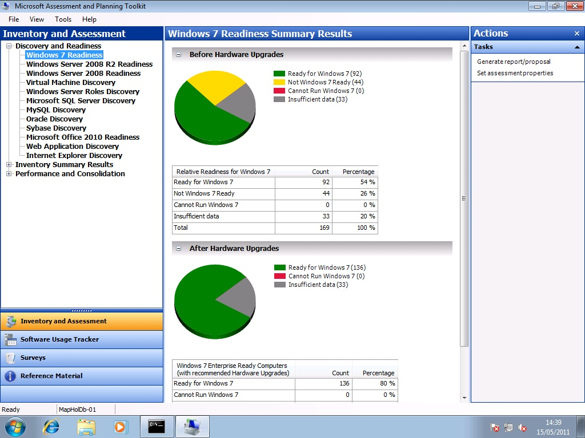
Tools to Assist In the Inventory Phase
MAP Toolkit
Thorough view of the state of the server
ready-made "readiness" reports
Powershell
Extremely flexible and can gather as much data as you’d like
Other enterprise products include Microsoft's own System Center Configuration Manager, Altiris among others

Slide 14
Assessment
Planning and testing phase
It's about weighing options as well as testing workloads in new environments and see how they react

Slide 15
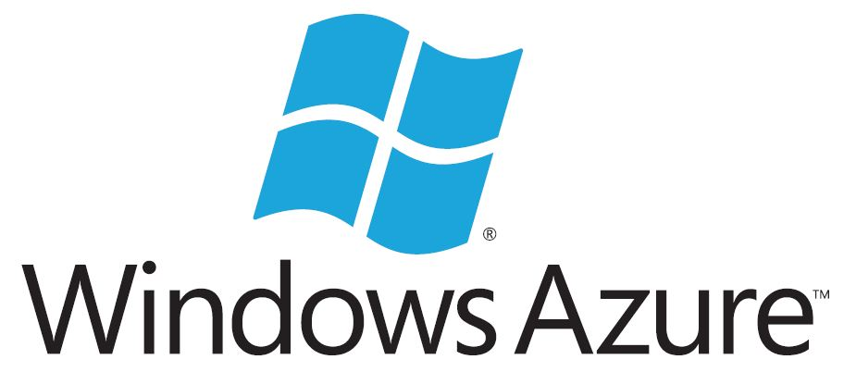

Deciding on a Migration Target: The Cloud
The cloud offers less management, more flexibility and lower costs
Some workloads (especially legacy workloads) aren't necessarily going to run well in the cloud

Slide 16
Deciding on a Migration Target: Physical vs Virtual
Leverage virtualization if you can:
Vmware
Hyper-V
Do the workloads you're migrating support virtualization?

Slide 17
Deciding on a Migration Target: x86 to x64 Architecture
Advantages of x64 architecture
Faster, more resourceful architecture
Access to more memory and CPU
Industry standard for future
x86
x64
Are all the services on that machine capable of running on an x64 architecture?

Slide 18
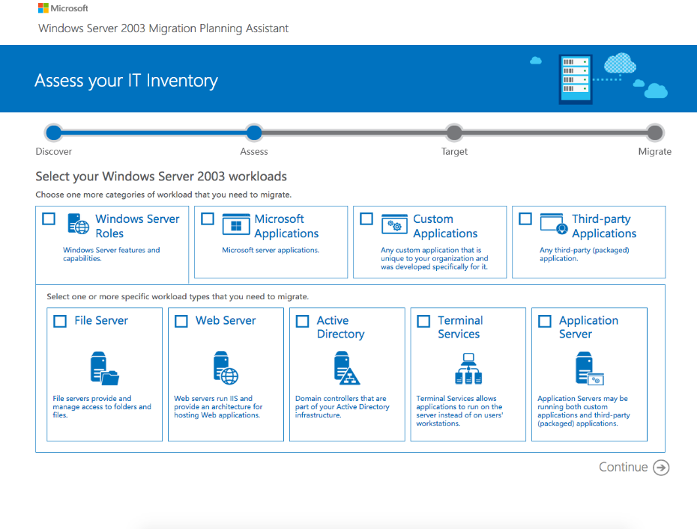
The Windows Server 2003 Migration Planning Assistant
Invaluable resource for migration planning
Information for every kind of workload
Intuitive to use
Does not provide technically deep information

Slide 19


Testing
Test to play with scenarios
Test to see how workloads behave on new servers
Utilize the physical to virtual tools
Disk2Vhd
Availability Suite

Slide 20
Migration
You've properly inventoried and assessed your workloads
You've ensured all your workloads are compatible with your target
You've tested the scenario

Slide 21
Backups, Backups, Backups
Account for the “what if” scenarios
Backup the physical server itself
Microsoft's VSS backup utility
Veeam has a great and FREE Endpoint Backup product

Slide 22
Hiring Outside Help
Migration is going to be a one-off event
Consultants are good for migrations which can pass off support later on
Consultants are typically experts in their fields and have usually performed several migrations
Might not be an option when budget it low

Slide 23
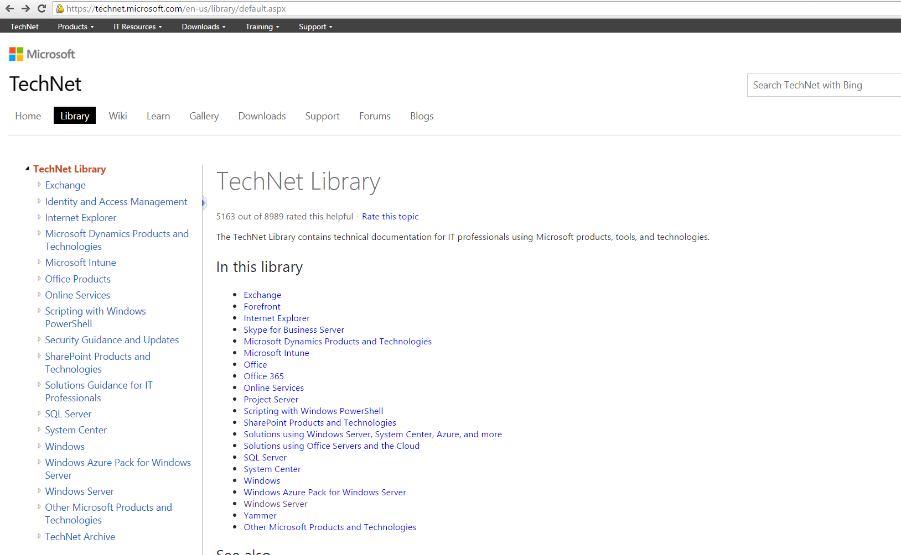
Tools to Help
Windows Server Migration Tools
Can help migrating Windows server roles like Active Directory, DHCP, DNS, etc.
Technet Script Repository
Lots of script resources
Must know how to script with Powershell

Slide 24
Decommissioning
You probably ARE going to forget something before turning off your old server!

Slide 25
Is it Really, Really Not Being Used Anymore?
Are you missing something??

Slide 26
Decommissioning Strategies
Log files/
Event logs
Applying a host-based firewall
A packet sniffer
Shut it off
log
Look for data traffic originating from the outside
Monitor activity through event logs and common log files
Restrict all incoming connections and monitor the firewall log
Ensure Server 2003's demise

Slide 27
Helpful Resources
The Migration Planning Assistant http://migrationplanningassistant.azurewebsites.net/
The Migration Planning PDF http://winmigrationproduction.blob.core.windows.net/windows2003migrationoverview/Windows%20Server%202003%20EOS%20Migration%20Overview.PDF
Microsoft Virtual Academy http://www.microsoftvirtualacademy.com/training-courses/migrate-legacy-windows-server-to-2012-r2-and-microsoft-azure
Veeam and the End of Windows Server 2003 Support Whitepaper http://hyperv.veeam.com/windows-server-2003-end-support-solutions-4791/
Top Cloud Computing Solutions http://www.tomsitpro.com/articles/cloud-computing-solutions,1-1755.html
SQL Server Migration Assistant

Slide 28
Thank you!
Adam Bertram
adamtheautomator.com

